Slide 1
CA683 Data Analytics and Data Mining
Assignment
Group - 5
Raghavi Prem Kumar (22264121)
Tripti Bharadwaj (22260190)
Apoorva Vittal Gowda (22263504)
Vasanthan Suresh (22260609)

Slide 2
Can we predict the number of views for a YouTube video using CHANNEL STATISTICS?
BUSINESS UNDERSTANDING
Youtubers earn money through ad revenue which follows a cost-per-view model i.e., more the ad views the video gets the more revenue.
Channel statistics and video statistics includes the features – subscriber count, likes, dislikes, comment count, title, video definition, video duration , etc.
In this project we intend to analyze youtube video titles and other descriptive features to predict a video’s view.

Slide 3
Previous research work
PAPERS | FEATURES | OUTPUT/METHODS | YEAR
Content unaware features and its influence on popularity of a YouTube video – (Zahid et al.,) [1] | likes, dislikes, comment count, sentiments of the comments in terms of percentages, title | Output – Derived column (trending/non trending ) Classification – SVM, k-NN | 2022
Optimizing Prediction of YouTube Video Popularity Using XGBoost – (Meher Un Nisha et al.,) [2] | Video Definition, Video Duration | Output – Number of views Regression – XGBoost Regressor | 2021
Predicting popularity of video using number of Views – (Tomasz et al.,) [3] | Video features like frames, #faces in the video, dominant colour, likes, comments | Output – Number of views Regression – SVM Regressor | 2017

Slide 4
PROPOSED WORK
Data Source: Kaggle (link) , YouTube V3 API
Details of trending YouTube videos uploaded on a Daily basis for several countries.
Time Period – July 2020 to 4th March 2023
Countries – US, Canada, India, Great Britain
Rows ~ 7 million
X variables ( Independent) | Y variable ( Dependent)
From CSV Title Number of likes Number of dislikes Comment count From JSON Category From YouTube V3 API Subscriber count Video duration Video definition | Number of Views

Slide 5
PRE-PROCESSING
Pre-processing
Considerations
Countries: US, GB, Canada, India
Only English Titles using Google Translate API
De-duplication –Duplicate Video titles with maximum views and latest trending date was taken
Combined the CSVs of the four countries.
Merged the category from JSON using category_id.
Included video statistics attributes like duration, video definition from YouTube API V3.

Slide 6
Feature extraction
Title extracted features | Date extracted features | API Features
Number of words Number of characters Punctuations Average word length Ratio of stop words Sentiment of the title – hugging face transformer | Weekday/Weekend Day of the week Quarter of the year Month of the year Year | Subscriber count Video duration Video definition

Slide 7
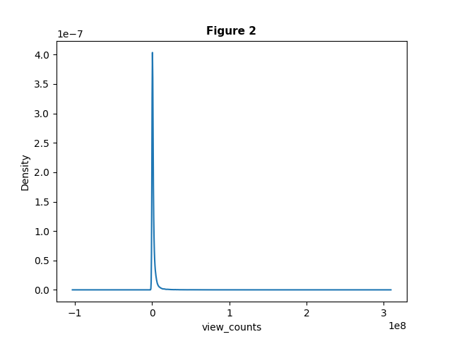
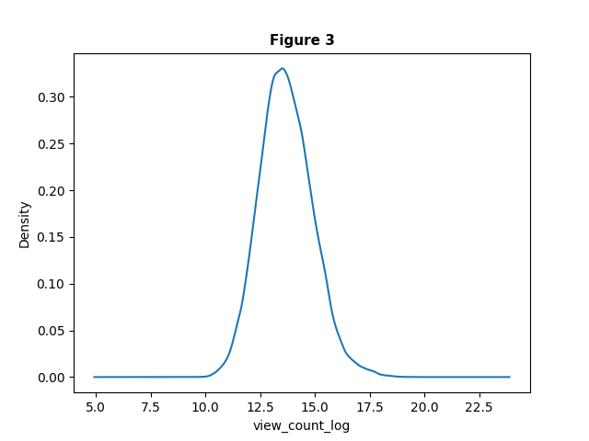
EXPLORATORY DATA ANALYSIS
Number of view counts was enormous thus; we converted it to a log scale for this variable to normalize.
2. Correlation between view counts and other features are –
Likes – 53.6 %
Dislikes – 26.6 %
Comment counts – 22.3 %
Characters and words – 10.5 % and 9 %
Multicollinearity checks using Variance Inflation factor (VIF ) showed high values for
#characters, #words, average word length , etc.
4. Hence Principal Component Analysis (PCA) and Multiple Correspondence Analysis (MCA) were employed

Slide 8
MODEL Iterations and Evaluation
XGBoost Regressor and Support Vector Machine with RBF kernel were used based on research.
The MAE ( Mean Absolute Error) and RMSE (Root Mean Square Error) were quite high when model was trained only using title features . Hence other features were included.
According to the literature and our analysis the highly correlated features are – "Likes," "Dislikes“, "comment count“ and title extracted features like #words, #characters,etc.
Model evaluation - Akaike information criterion(AIC)
Performance of each model was tested using Mean Absolute Error(MAE)
 | SVM AIC | XGB AIC | #features
Extracted variables | 65 | 68 | Numerical - 16 Categorical - 27
PCA and raw categorical | 37 | 39 | PCA components - 2 Categorical - 27
PCA and MCA | 19 | 21 | PCA components - 2 MCA components - 18
AIC Scores for the models used

Slide 9
MODEL Iterations and Evaluation
 | SVM |  | XGboost
 | Train | Test | Train | Test | SVM (test-train) | XGB (test-train)
Extracted variables | 0.613 | 0.615 | 0.306 | 0.351 | 0.002 | 0.045
PCA and raw categorical | 0.608 | 0.609 | 0.379 | 0.406 | 0.001 | 0.027
PCA and MCA | 0.608 | 0.609 | 0.397 | 0.421 | 0.001 | 0.024
MAE for different Iterations (Train and Test)

Slide 10
CONCLUSION AND FUTURE WORK
XGboost with PCA and MCA combined gave the best results.
All the numerical variables that describe the video from different domains can be fit into just two principal components.
The project also proved the increase in stability of nonlinear models by reducing the features without reducing the variance in the data.
Future Work
Decode thumbnails of the videos to extract like the number of faces, the colour of the thumbnail, etc.
Analyze the video framewise to understand the content of the video.
Combining content and descriptive features may help in improving the accuracy of the prediction

Slide 11
REFERENCES
Halim, Z., Hussain, S. and Ali, R.H., 2022. Identifying content unaware features influencing popularity of videos on youtube: A study based on seven regions. Expert Systems with Applications, 206, p.117836.
Nisa, M.U., Mahmood, D., Ahmed, G., Khan, S., Mohammed, M.A. and Damaševičius, R., 2021. Optimizing Prediction of YouTube Video Popularity Using XGBoost. Electronics, 10(23), p.2962.
Trzciński, T. and Rokita, P., 2017. Predicting popularity of online videos using support vector regression. IEEE Transactions on Multimedia, 19(11), pp.2561-2570

Slide 12
THANK YOU !!!

